Slide 1
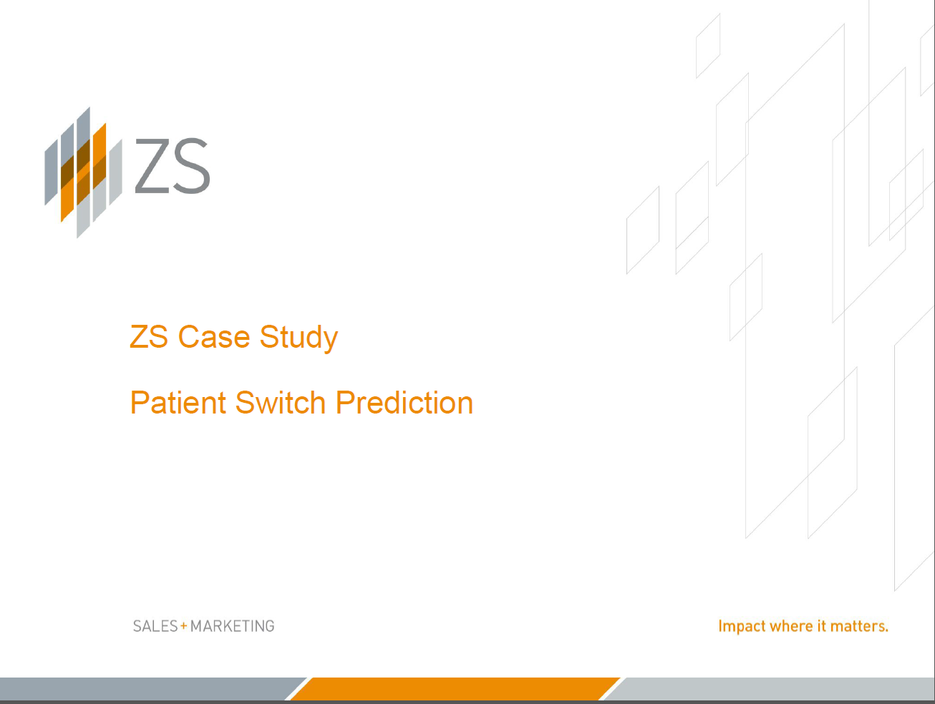
Rajat Ranjan
Infosys (EdgeVerve ) Melbourne AU
https://www.linkedin.com/in/rajat-ranjan24/
Contact : rajat5ranjan@gmail.com
Number: +61 432028099/ +91 9886043959

Slide 2
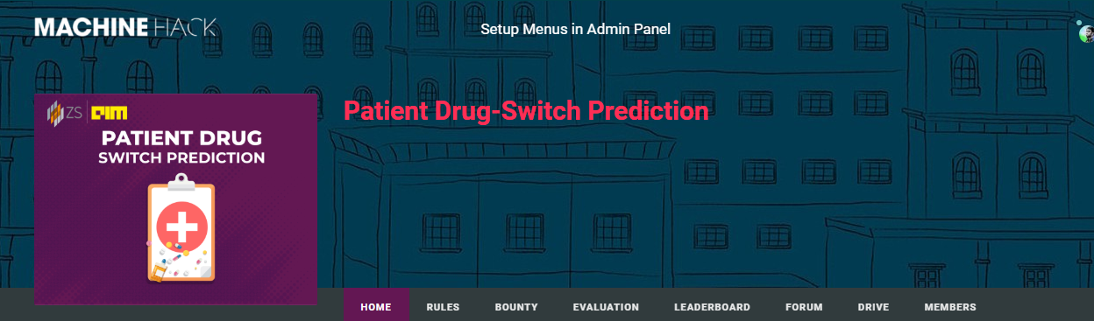
Problem Statement
Armanik, a multinational pharmaceutical company based in Texas, USA, is one of the largest pharmaceutical companies by both market capitalization and sales. Armanik manufactures drugs across multiple therapy areas – Cardiovascular, Diabetes, HIV and Immunology therapy. Their innovative SGLT 2 is the market leader in diabetes therapy. Recently, the company announced that they have successfully completed a Phase 3 trial for an Anti-TNF drug in Rheumatoid Arthritis therapeutic. The company expects to get approval for its new drug in the next 6 months. Given the competition in the market, Prakash Vishwanathan, CEO of Armanik, has reached out to ZS to help identify the patient population in the U.S who are likely to switch any product in the RA market. ZS has proposed a machine learning-based approach using medical transactional data to first identify the factors that are most closely associated with the switching RA patients that will help predict patients who are likely to switch in the near term.

Slide 3
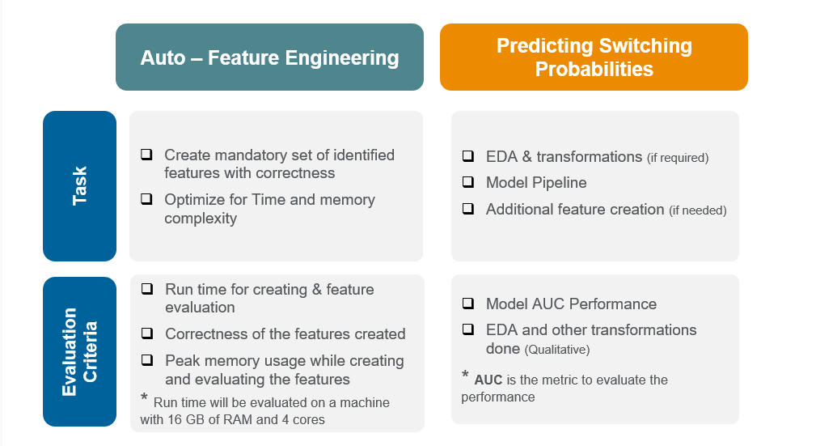
Objectives

Slide 4
Objective 1
Auto feature Engineering
All Features are created using given ‘Feature_Pipeline.py’ with another ‘feature_generators.py’ which holds the logic to create the features.
In a Machine (8GB RAM, i5 7th Gen)
Recency features took – 1 Minutes
Frequency Features took – 30 Minutes
NormChange Features took – 13 Minutes
Total time – 40-45 minutes
In Kaggle https://www.kaggle.com/rajatranjan/kernel28f3c5f327
45 Minutes
With Multiprocessing (Pool with 4 worker process) the whole execution took 24 minutes.
Enhancements
Use of multiprocessing ( Pool) in python to create features in a much more faster way. (Code provided)
It can much more enhanced by optimising the code further for Frequency and NormChange Features.

Slide 5
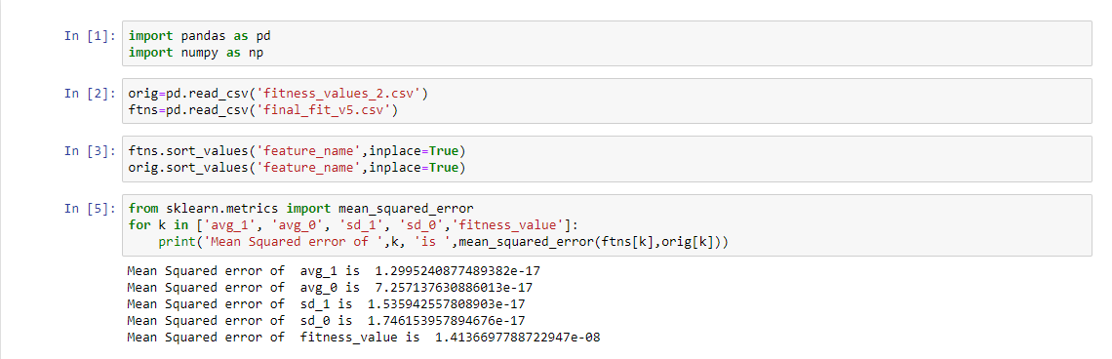
Objective 1
Fitness Calculation and Verification

Slide 6
Objective 2 -Patient Switching Probabilities
Approach
Kernel 1
Feature Generation
Aggregate Features on Train_data by ‘patient_id’ such as ‘event_name_count’, ‘event_time_sum’ etc creating 19 Features.
Recency features created and aggregated on combination of patient_id and ‘event_name’, ‘specialty’, ‘plan_type’ creating another 75k Features
Modelling
LGBM model used in Training with use of various hyper parameters.
Evaluation Metric was taken ‘AUC ROC’ score with sklearn.metrics.
Feature Importance recorded for top 300 Features.
15 Fold StratifiedKFold prediction were modelled around LGBM model (resolves the problem of equal binary probabilities)
Mean of all 15 Folds were taken for submission.
LB Score – 85.672 AUC

Slide 7
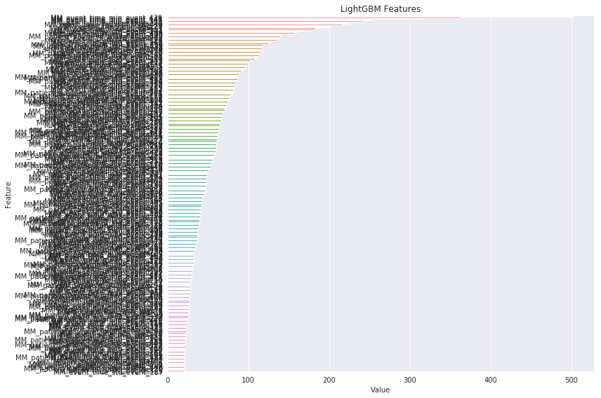
Feature Importance Kernel 1

Slide 8
Objective 2 -Patient Switching Probabilities
Approach
Kernel 2
Feature Generation
Aggregate Features based on combination of ‘patient_id’ and ‘event_name’, ‘specialty’, ‘plan_type’ were created and merged with original train data creating total of 12 features
Aggregate Features on Train_data by ‘patient_id’ consisting newly created features above such as ‘event_name_count’, ‘event_time_sum’ etc creating 144 Features in total.
Recency features created and aggregated on combination of patient_id and ‘event_name’, ‘specialty’, ‘plan_type’ creating total of 898 Features.
Modelling
LGBM model used in Training with use of various hyper parameters.
Evaluation Metric was taken ‘AUC ROC’ score with sklearn.metrics.
Feature Importance recorded for top 300 Features.
10 Fold StratifiedKFold prediction were modelled around LGBM model (resolves the problem of equal binary probabilities)
Mean of all 10 Folds were taken for submission.
LB Score – 85.028 AUC

Slide 9
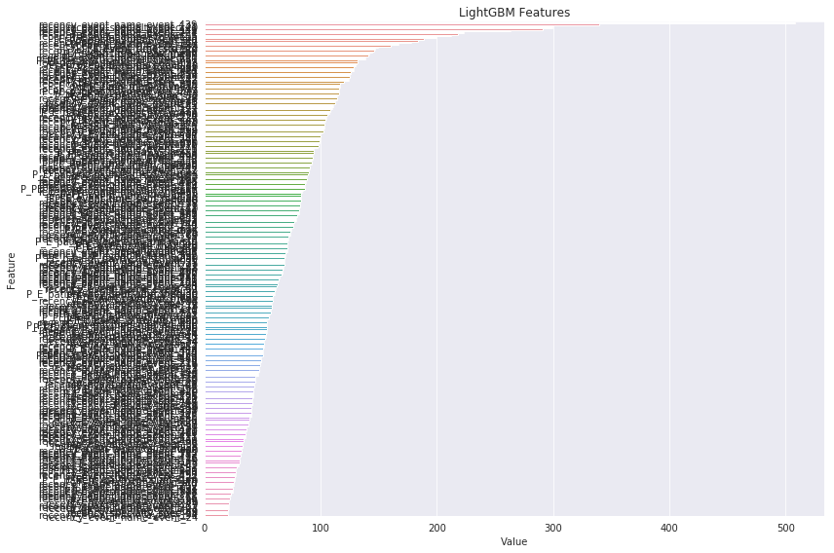
Feature Importance Kernel 2

Slide 10
Ensembling Predictions
Ranking (scipy.stats.rankdata)
Both the submission were used with rankdata to created a new submission file
LB Score : 86.181
Things Tried that didn’t worked out
Models – Catboost, XGB, and other like Logistic Regression and NN
Created more features with any feature importance
EDA with different combinations of patient id with patient_payments etc
Feature selection using LGBM feature importance.

Slide 11
Conclusion & Enhancements
Recency features were much help which increased the score from 64 to 83.XX AUC directly.
Frequency and NormChange features didn’t worked out for me.
Thanks
Portfolio
https://www.linkedin.com/in/rajat-ranjan24/ [Linked In]
https://github.com/rajat5ranjan/ [Github]
https://rajat5ranjan.github.io [Github Website]
https://www.kaggle.com/rajatranjan/ [Kaggle]
http://www.hackerearth.com/@rajat5ranjan [Hackerearth]
https://boiling-lowlands-55895.herokuapp.com/ [Heroku Portfolio]

